Slide 1
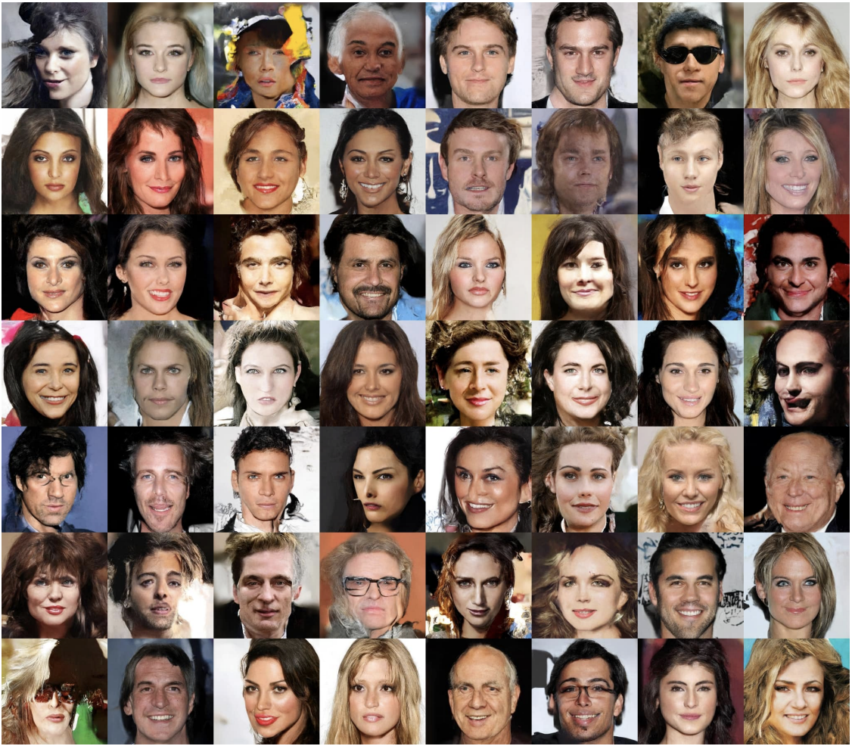
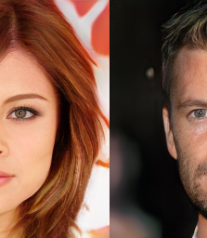
Facial GANs and Facial Expressions
A Capstone Project by Lawrence Quesada

Slide 2
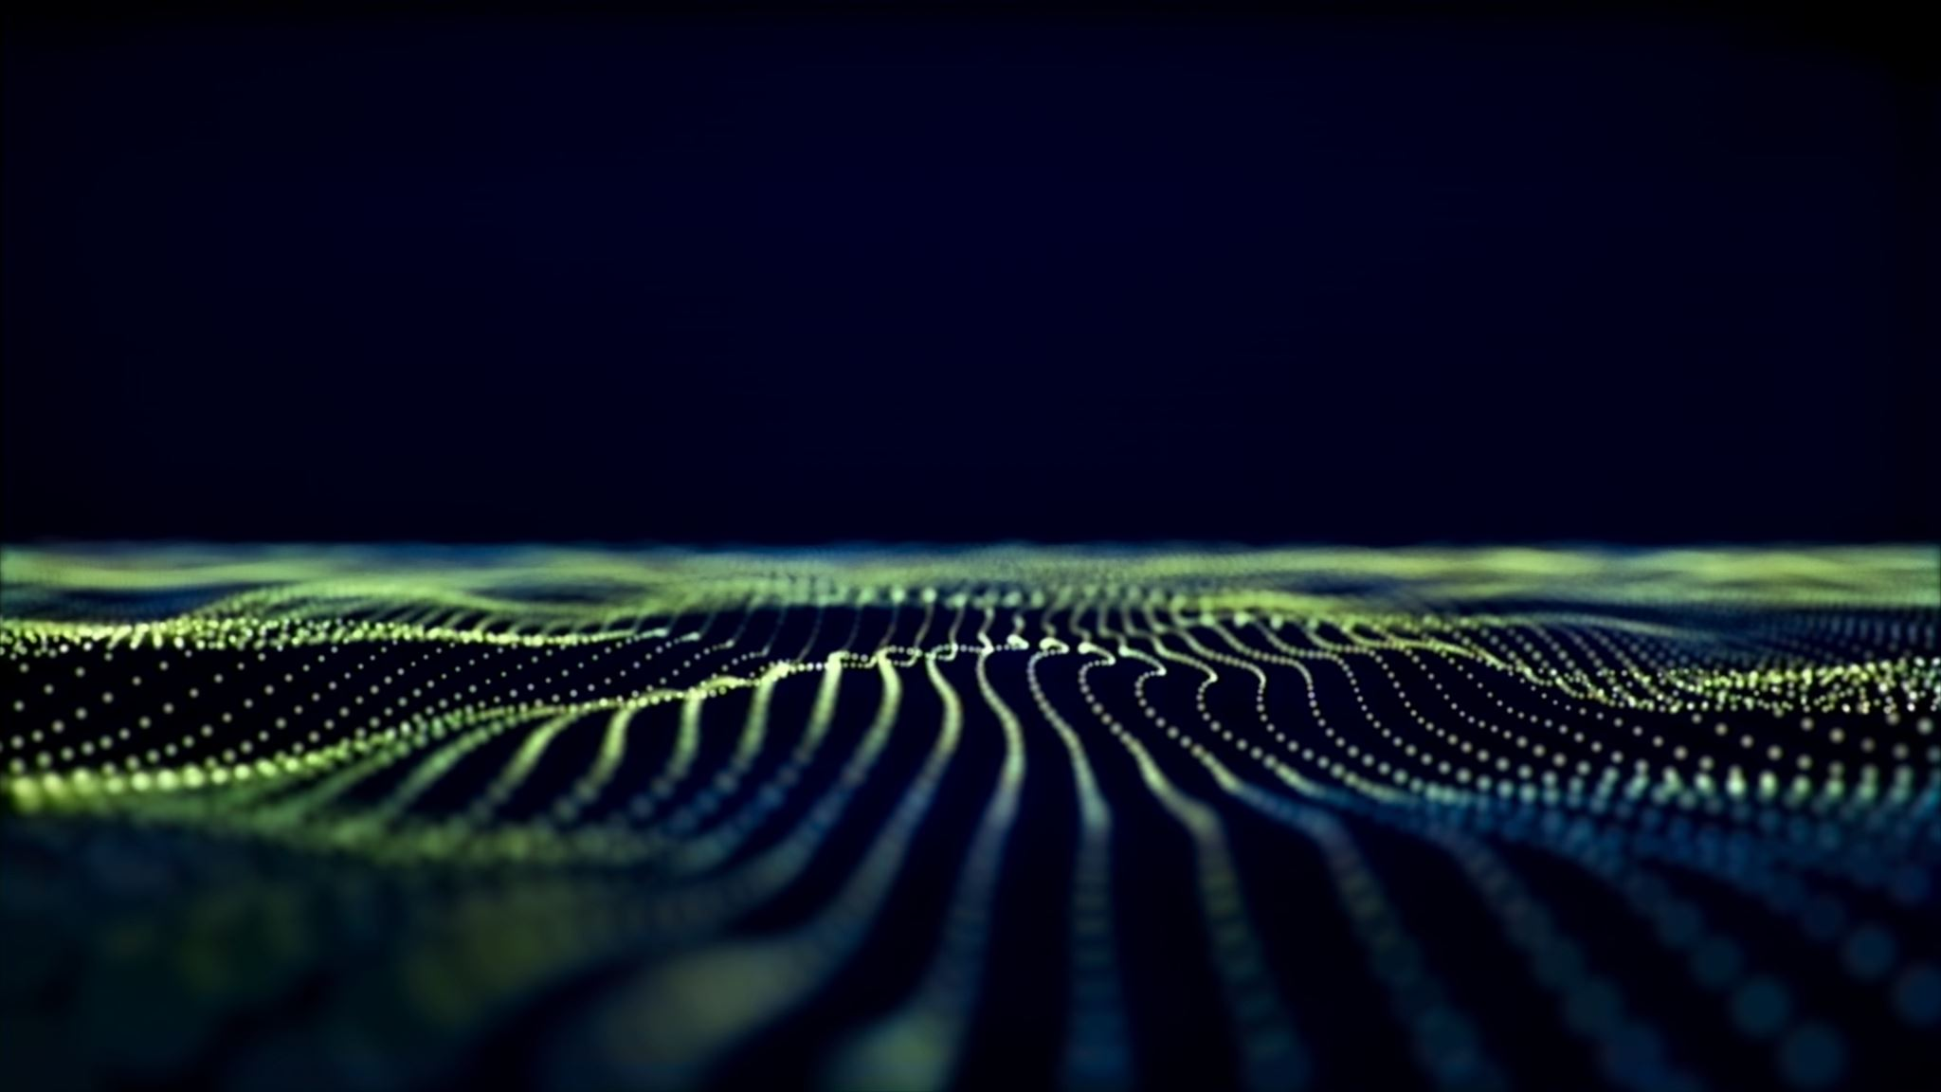
Contents
The Dataset
01
Exploratory Data Analysis
02
Pre-Processing
03
Building the Model
04
Results
05
Target Audience / Conclusion
06
Future Considerations
07

Slide 3



data source
https://susanqq.github.io/UTKFace/
The UTKFace image dataset is available for non-commercial research purposes only. It is maintained by ssusanqq
Contact information for any questions with regards to the dataset are Yang Song and Zhifei Zhang.

Slide 4
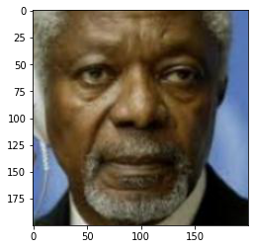
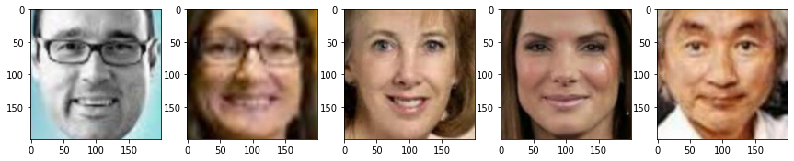

Slide 5
Collection of Images
Male
Female
Filter ‘Age’ group from 20 to 70

Slide 6
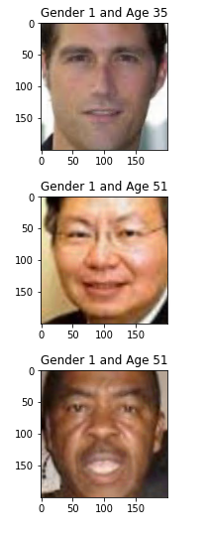
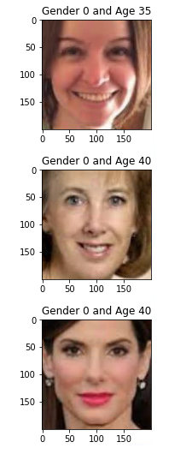

Slide 7
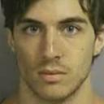










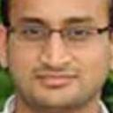
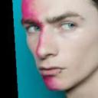
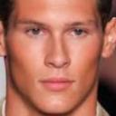


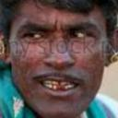

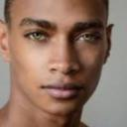



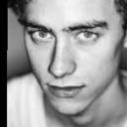
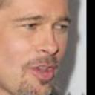













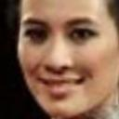










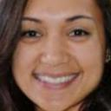

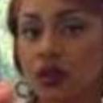


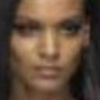
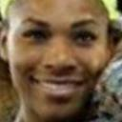
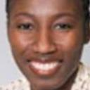
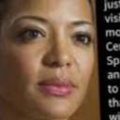
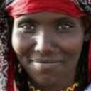


TrainA_Male
TestA_Male
TrainB_Female
TestB_Female

Slide 8
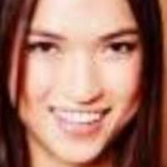
Rescale / Resize
200x200
128x128

Slide 9
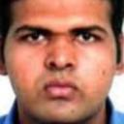


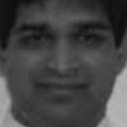
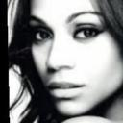

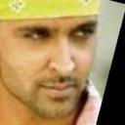




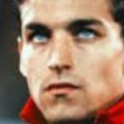







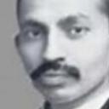



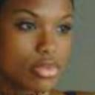




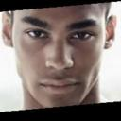
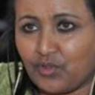
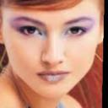




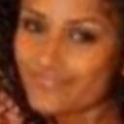
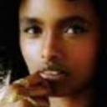
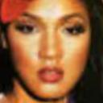


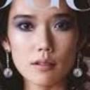




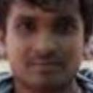




Generator A
?

Slide 10
Generator B
?

Slide 11
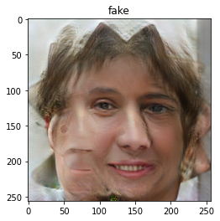
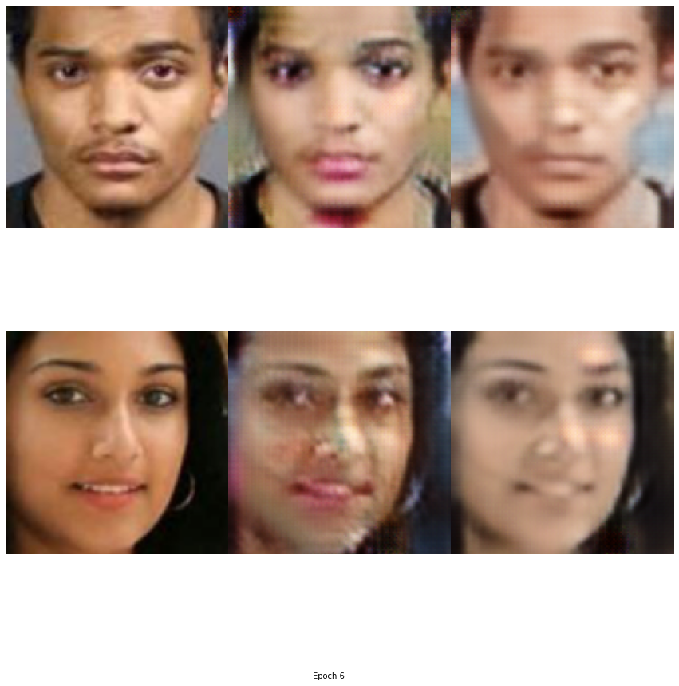
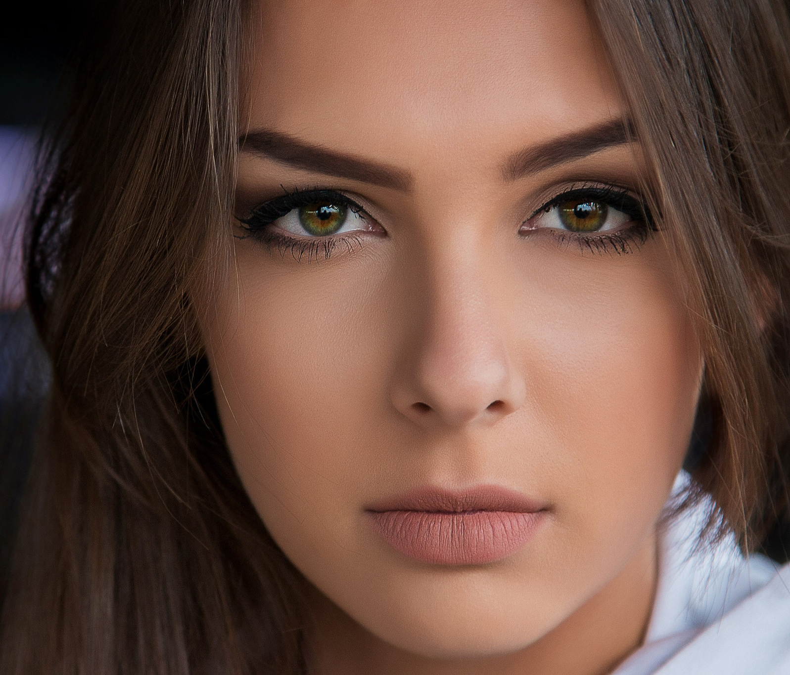



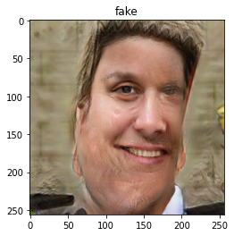
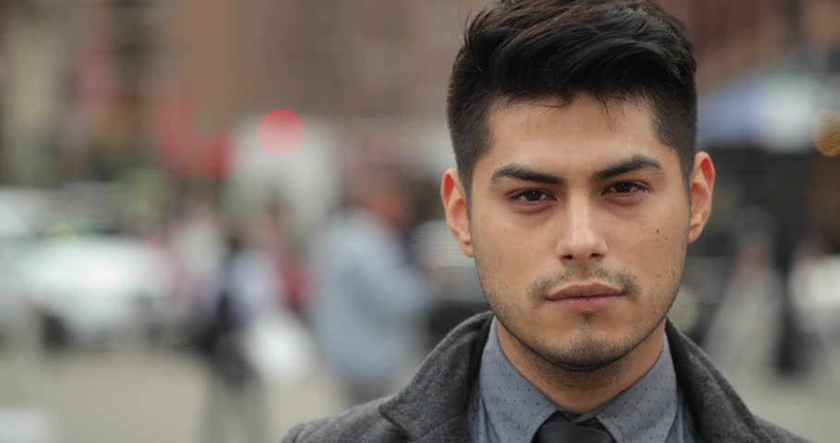
Discriminator

Slide 12
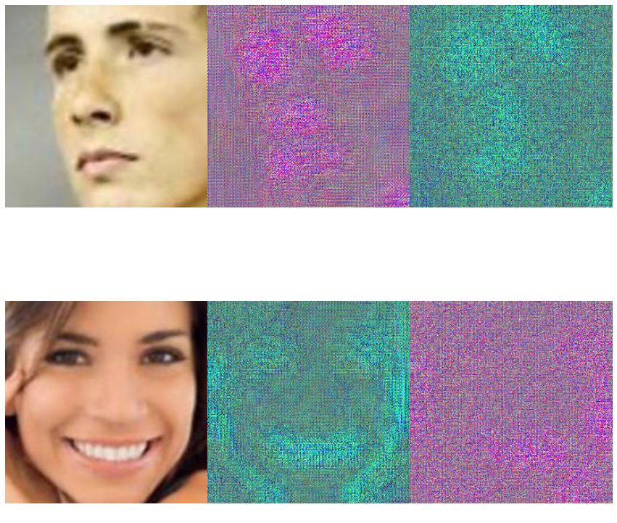
Model Results

Slide 13
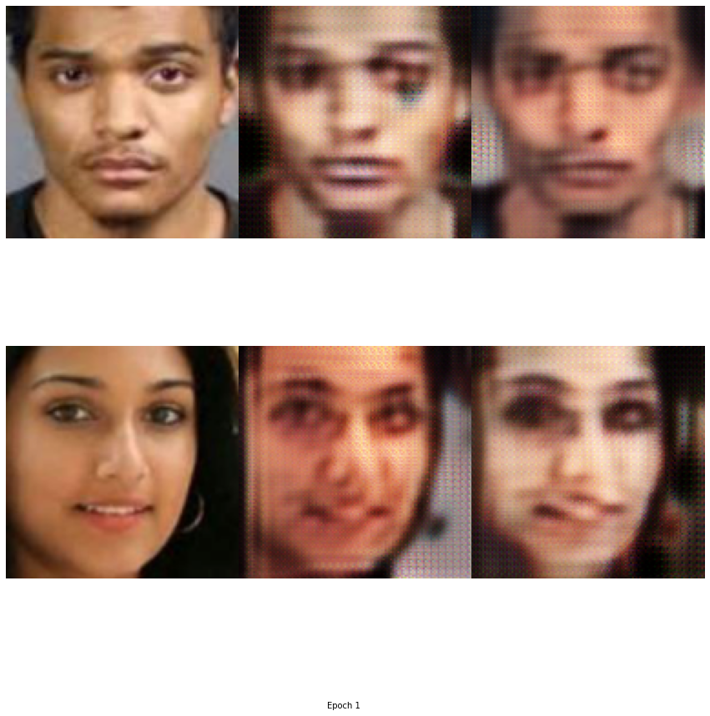
100%
236/236 [32:04<00:00, 8.15s/it]
Epoch [1/100], Step [1/236],
Discriminator_A_losses: 0.7786,
Discriminator_B_loss: 0.6268,
Generator_A_loss: 1.1148,
Generator_B_loss: 1.4634
Epoch [1/100], Step [101/236],
Discriminator_A_losses: 0.1777,
Discriminator_B_loss: 0.1618,
Generator_A_loss: 0.3874,
Generator_B_loss: 0.4348
Epoch [1/100], Step [201/236],
Discriminator_A_losses: 0.1444,
Discriminator_B_loss: 0.1850,
Generator_A_loss: 0.6305,
Generator_B_loss: 0.4485

Slide 14
100%
236/236 [01:31<00:00, 2.57it/s]
Epoch [5/100], Step [1/236],
Discriminator_A_losses: 0.1527,
Discriminator_B_loss: 0.1267,
Generator_A_loss: 0.4968,
Generator_B_loss: 0.3262
Epoch [5/100], Step [101/236],
Discriminator_A_losses: 0.1517,
Discriminator_B_loss: 0.1773,
Generator_A_loss: 0.2407,
Generator_B_loss: 0.5700
Epoch [5/100], Step [201/236],
Discriminator_A_losses: 0.1561,
Discriminator_B_loss: 0.1838,
Generator_A_loss: 0.5190,
Generator_B_loss: 0.2752

Slide 15
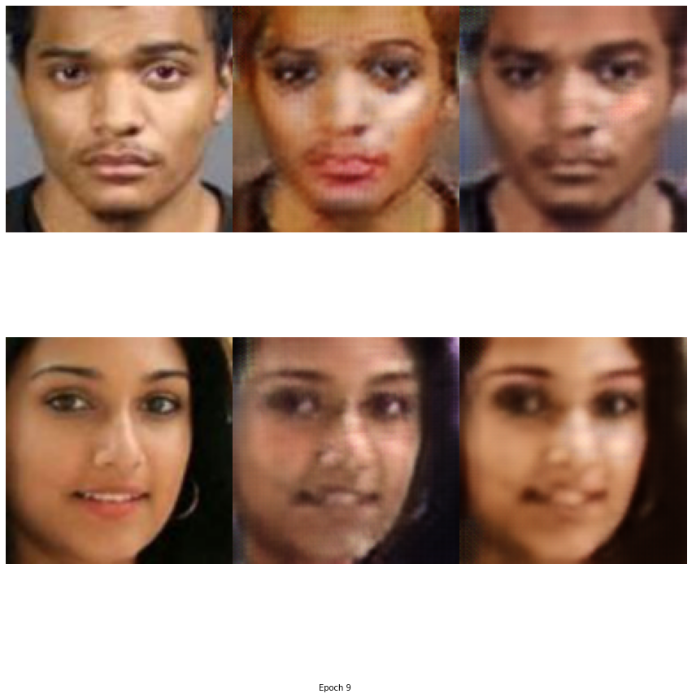
236/236 [01:21<00:00, 2.88it/s]
Epoch [8/100], Step [1/236],
Discriminator_A_losses: 0.1340,
Discriminator_B_loss: 0.1680,
Generator_A_loss: 0.3249,
Generator_B_loss: 0.2611
Epoch [8/100], Step [101/236],
Discriminator_A_losses: 0.0709,
Discriminator_B_loss: 0.1250,
Generator_A_loss: 0.3755,
Generator_B_loss: 0.5953
Epoch [8/100], Step [201/236],
Discriminator_A_losses: 0.0838,
Discriminator_B_loss: 0.1699,
Generator_A_loss: 0.2567,
Generator_B_loss: 0.6284

Slide 16
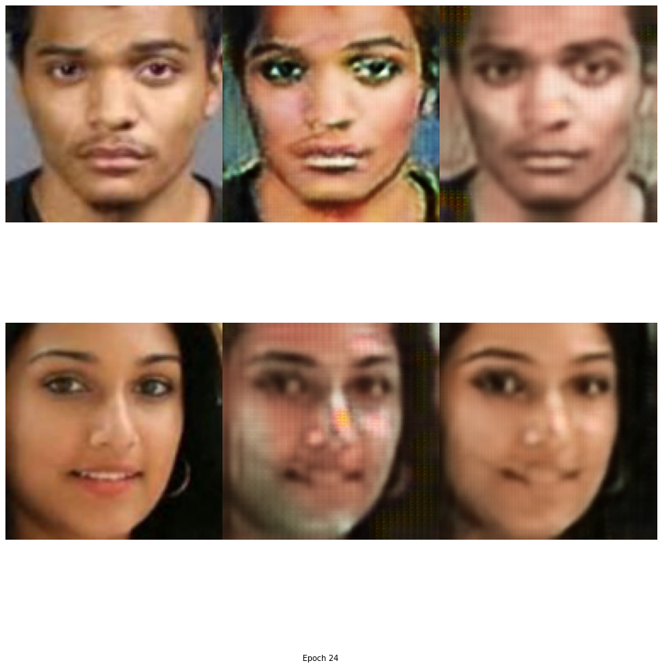
Epoch [24/100],
Step [1/236], Discriminator_A_losses: 0.0618,
Discriminator_B_loss: 0.0999,
Generator_A_loss: 0.4757,
Generator_B_loss: 0.5612
Epoch [24/100], Step [101/236],
Discriminator_A_losses: 0.2408,
Discriminator_B_loss: 0.0940,
Generator_A_loss: 0.3927,
Generator_B_loss: 0.2919
Epoch [24/100], Step [201/236],
Discriminator_A_losses: 0.2282,
Discriminator_B_loss: 0.1568,
Generator_A_loss: 0.5612,
Generator_B_loss: 0.3157

Slide 17
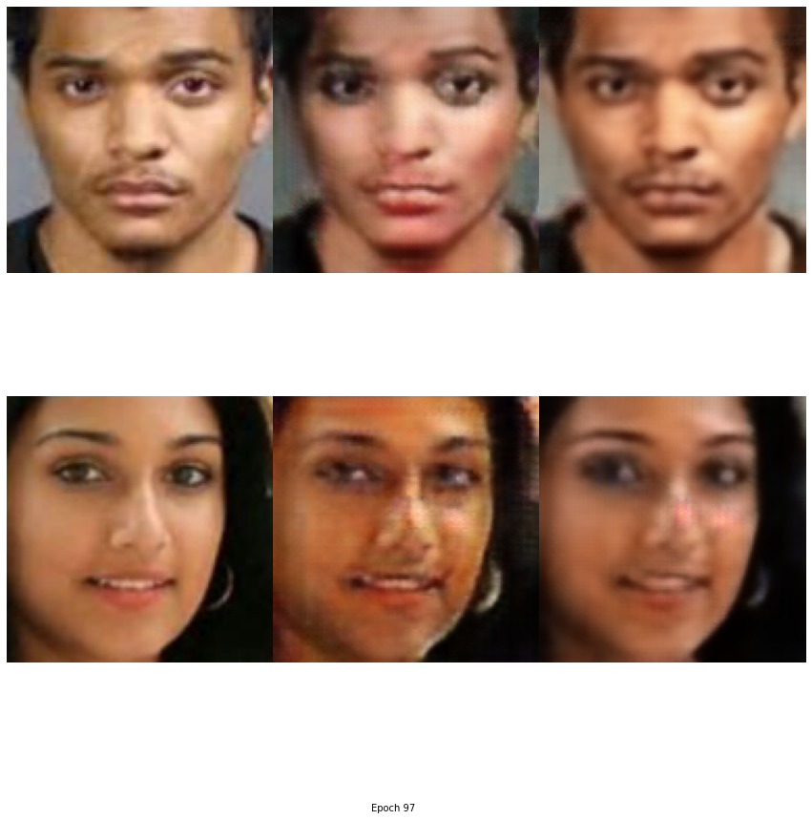
Epoch [97/100], Step [1/236],
Discriminator_A_losses: 0.2265,
Discriminator_B_loss: 0.0664,
Generator_A_loss: 0.5438,
Generator_B_loss: 0.2655 Epoch [97/100],
Step [101/236],
Discriminator_A_losses: 0.2181,
Discriminator_B_loss: 0.1043,
Generator_A_loss: 0.4390,
Generator_B_loss: 0.2524
Epoch [97/100], Step [201/236],
Discriminator_A_losses: 0.2173,
Discriminator_B_loss: 0.0912,
Generator_A_loss: 0.8642,
Generator_B_loss: 0.2752

Slide 18
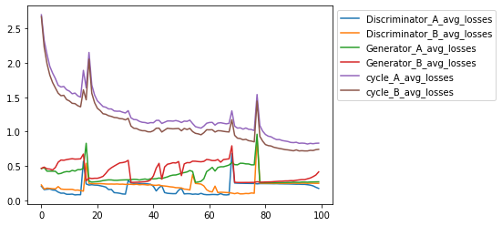
Plotting the Losses

Slide 19

Target
Audience
Consumers
Policy Makers
Academia / Research
Law Enforcement
Consider…
Ethical and Social Responsibility

Slide 20
Future Considerations
Appropriate Dataset
Ethnicities presented are equal
Gender covers Male and Female only
Alternative Datasets that are labeled
More Training Time / Epochs / Devices
Mix Precision
Backpropagation - Inverse as close to the original.

Slide 21
Questions?

